Slide 1


Prototype Submission Phase

Slide 2
TEAM NAME and MEMBER DETAILS
Team name – SUNEHRI
Team Member name (Single person)
Suniksha Ben Patel
THEME:
SkillBridge - AI-Powered Peer Learning Matchmaker

Slide 3
PROBLEM STATEMENT
The Traditional Education System lack personalization, leaving students struggling to find suitable learning resources and peers. Private tutoring is expensive and inaccessible widening the educational gap , especially for underserved communities. Institutions hold untapped peer knowledge, but there is no efficient way to connect students with the right mentors.
Existing Learning platforms follow a one-size-fits all approach, neglecting individual learning styles and preferences, Post-COVID , online learning has surged , yet students face isolation and lack personalized mentorship.
SkillBridge-AI-Powered Peer Learning Matchmaker addresses this by intelligently connecting students with peer tutors based on skill, goals , and availability. This cost-effective solution promotes personalized learning, collaboration , and accessibility, bridging the educational gap effectively.

Slide 4
SOLUTION
SkillBridge – AI-Powered Peer Learning Matchmaker solves the problem by leveraging artificial intelligence to create personalized peer-learning experiences. The platform matches students with compatible peer tutors based on their skills, learning preferences, and availability.
How it helps to solve the problem:
AI-Powered Matchmaking: Uses machine learning algorithms to analyze student profiles and recommend ideal peer tutors for personalized learning.
Affordable and Scalable Solution: Provides cost-effective learning alternatives compared to private tutoring, making education accessible to all.
Engagement and Collaboration: Encourages interactive learning through scheduled sessions, progress tracking, and collaborative tools.
Data-Driven Insights: Tracks user engagement and learning progress to optimize matchmaking and improve learning outcomes.
Flexible Learning Options: Offers customized learning schedules to fit individual needs, promoting a self-paced and adaptive approach.
By combining AI with peer-based learning, SkillBridge creates a supportive and engaging educational ecosystem that fosters academic success and reduces the learning gap.

Slide 5
SOLUTION
What are the impact metrics that one can use to analyze the effect of the solution?
Learning Outcomes:
Engagement Metrics
Number of Active Users: Count of students and peer tutors using the platform regularly.
Session Completion Rate: Percentage of scheduled learning sessions completed successfully.
Time Spent on Platform: Average duration of user activity, indicating engagement.
Operational Metrics:
Skill Improvement: Measured through quizzes, assessments, or self-reported progress.
Tutor Effectiveness: Ratings and feedback from students about their peer tutors.
Subject Mastery Rate: Percentage of students achieving predefined milestones.
System Scalability: Ability to handle increased user demand across various subjects and institutions.
AI Accuracy: Match success rate of AI-powered tutor-student pairing.
Cost Efficiency: Operating cost per session or per user.

Slide 6
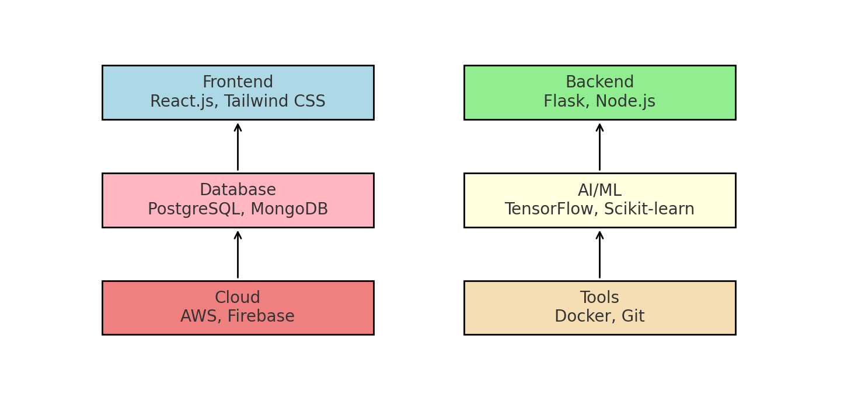
SOLUTION
Frameworks/Tools/Technologies stacks to be used

Slide 7

SOLUTION
Assumptions, constraints, and solution decision points (Reason behind choosing a technology)

Slide 8
SOLUTION
How easily can your solution be implemented and how effective will it be?
Ease of Implementation:
Clarity of Requirements: If your requirements are clear and well-defined, implementation is usually straightforward.
Technical Compatibility: If the solution leverages tools, libraries, or frameworks you're already familiar with, it can be implemented quickly.
Guidance Provided: I provide step-by-step instructions and examples, making it easier for you to follow and execute.
Resources and Skills: Your access to required skills, time, and tools can impact ease.
Effectiveness:
Relevance of the Solution: My solutions are designed based on the information you provide. The more accurate and detailed your input, the better the results.
Scalability and Flexibility: Solutions are tailored to be adaptable to your current and future needs whenever possible.
Feedback and Iteration: You can refine the solution iteratively with my support, ensuring it fits your context effectively.

Slide 9
SOLUTION
Scalability
Horizontal Growth: Add more servers/resources to support increasing users or workload.
Vertical Growth: Upgrade existing hardware or systems to boost performance.
Modular Design: Break down the system into independent, scalable components (e.g., microservices).
Usability
1. Intuitive UI: Ensure the interface is user-friendly and easy to navigate.
2. Accessibility: Design for inclusivity (e.g., compatibility with screen readers).
Extent of Scalability/Usability

Slide 10
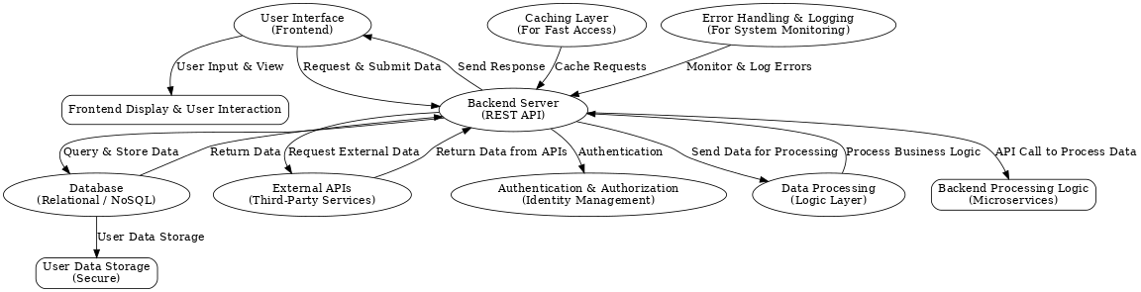
METHODOLOGY – Architecture Diagram

Slide 11
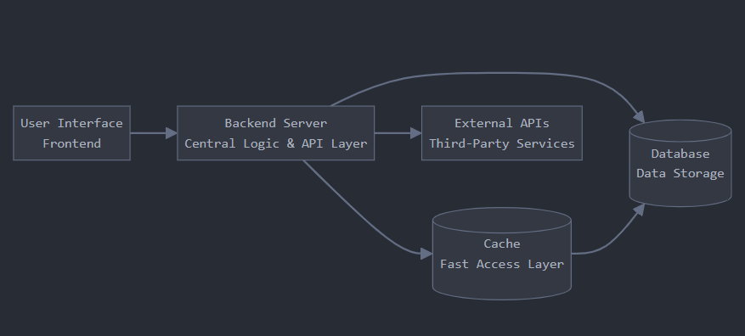
METHODOLOGY-Flowchart

Slide 12
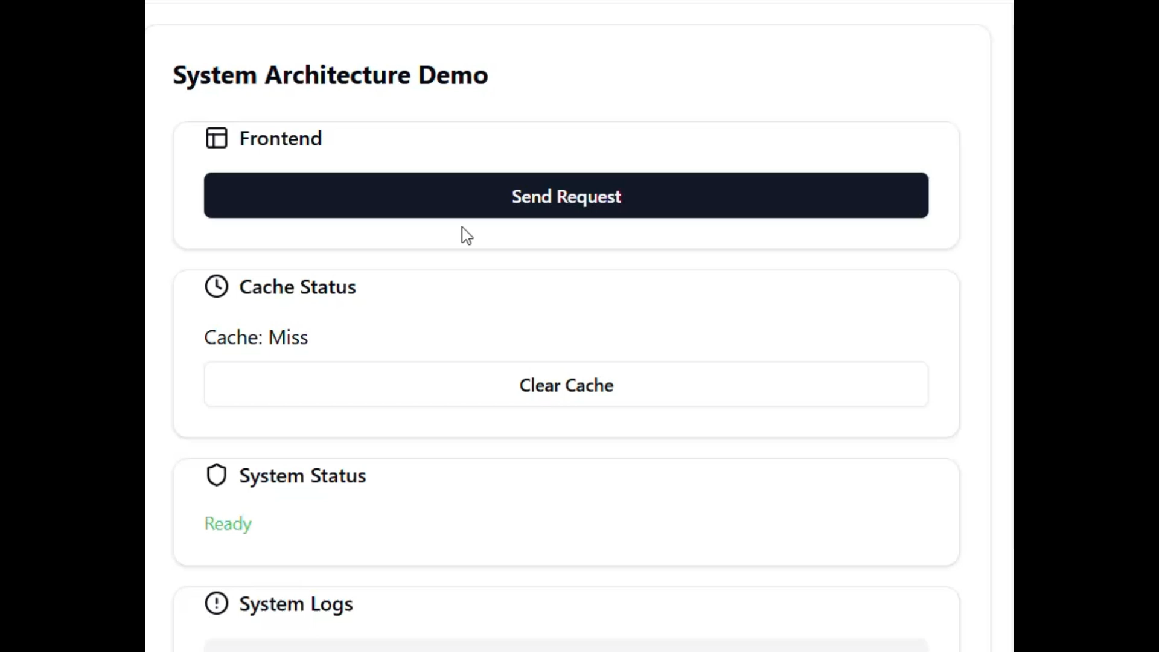
WORKING PROTOTYPE

Slide 13
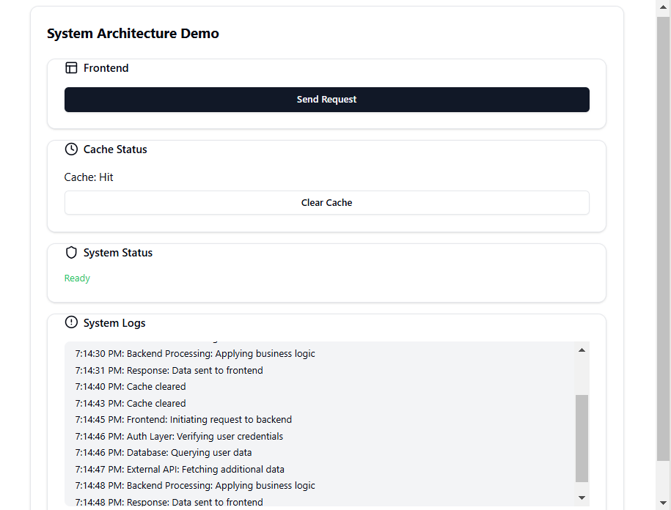
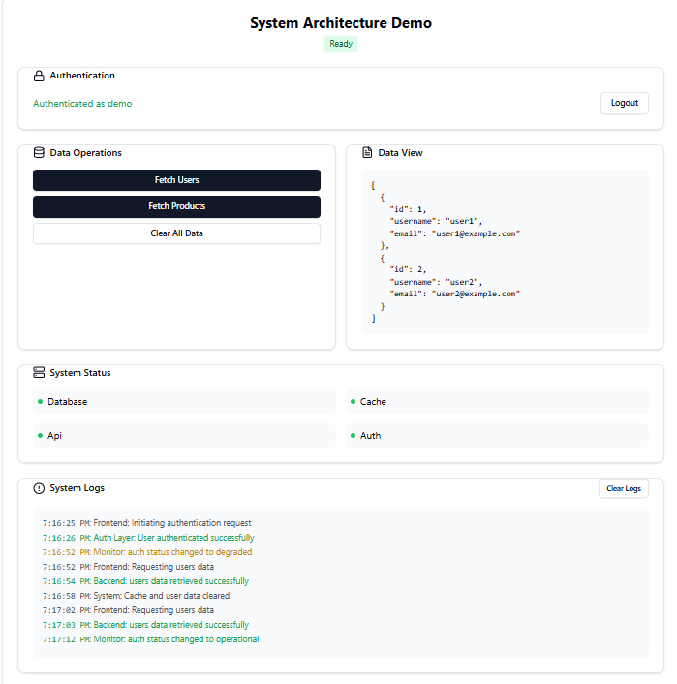
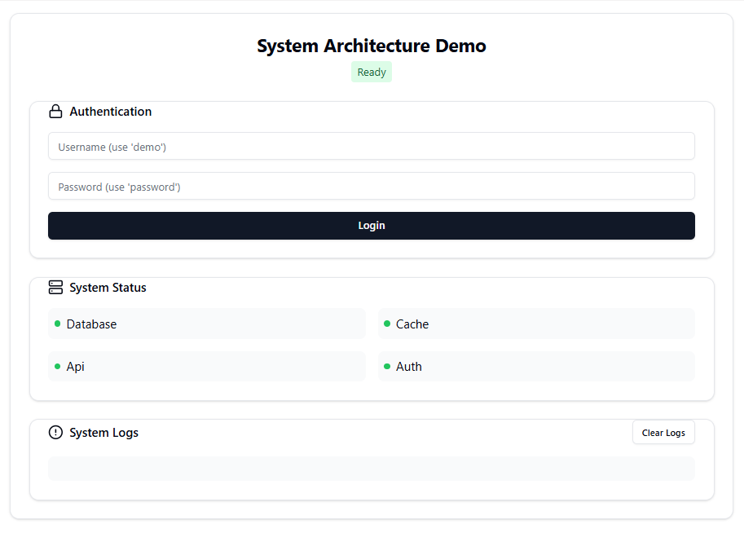
Attachments

Slide 14
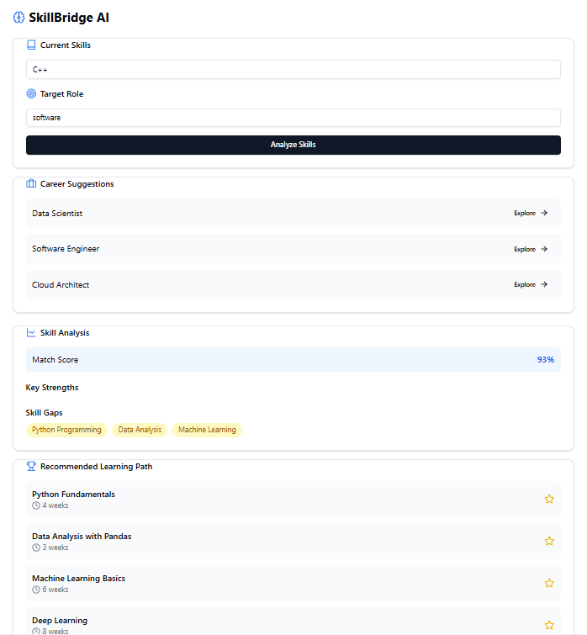
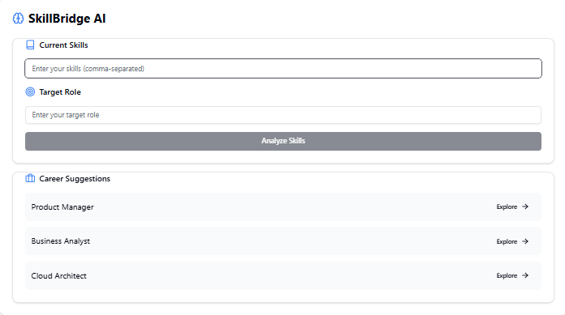
Attachments

